Slide 1
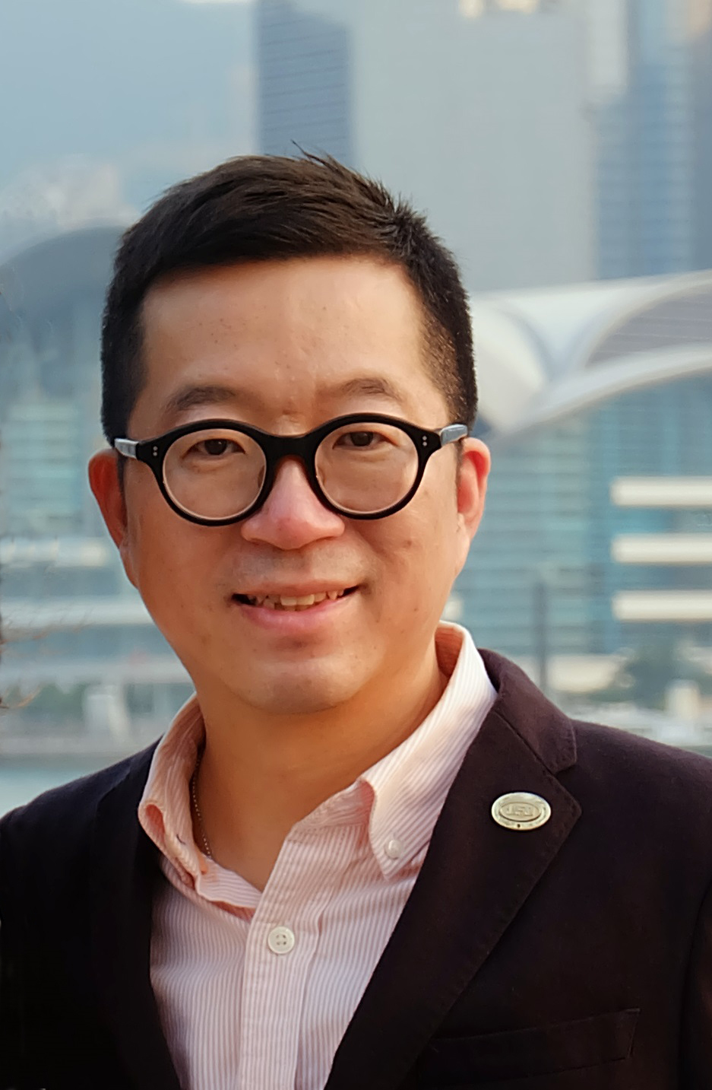
以TLS建立事業
Build Your Business with TLS Weight Loss Solution
Calvin Ip
總顧問經理級
National Supervising Coordinator
四個佣金週期共賺取HK$76,600*
HK$76,600 in 4 Commission weeks
*本簡報中提到的收入等級純屬舉例說明，無意代表美安香港超連鎖™店主的一般收入，也無意表示任何超連鎖™店主皆可賺取同等收入。美安香港超連鎖™店主的成功與否，取決於其在發展事業時的努力、才能與投入程度。The income levels mentioned in the following presentation are for illustration purposes only. They are not intended to represent the income of a typical Market Hong Kong UnFranchise™ Owner, nor are they intended to represent that any given Independent UnFranchise™ Owner will earn income in that amount. The success of any Market Hong Kong Independent UnFranchise™ Owner will depend upon the amount of hard work, talent, and dedication which he or she devotes to building his or her Market Hong Kong Business.

Slide 2
體重管理行業
每年 $800億
Weight Loss Industry
$80 Billion - Annually
The opportunity is
unlimited!!!
是無限的商機!!!

Slide 3
中國已是
世界排名第二的
“肥胖＂國家
中國逾3億人
屬於超重和肥胖人仕
China has become the
2nd largest
“Obesity” Country.
Over 300 millions people in China belongs to overweight and obesity
Source: http://health.takungpao.com.hk/hot/q/2015/0128/2904307.html

Slide 4
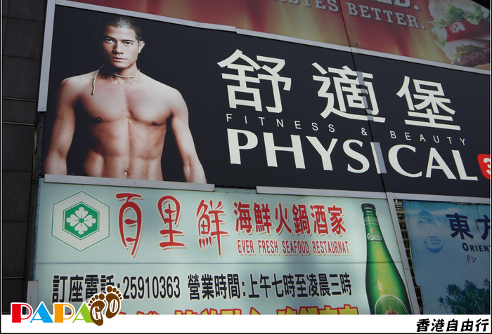







香港媒體曝光的
瘦身產品廣告高達
2400萬美元
Weight loss products advertisement in Hong Kong is up to
24 millions US dollar
Source: http://www.appledaily.com.tw/appledaily/article/finance/20031012/418474/

Slide 5
於二零一二年四月，香港人年齡介乎18至64歲之間的選定健康風險：
In April 2012, specific health risk for people aged between 18 -64 years old:
超重及肥胖
(體重指標23.0或以上)
Overweight and Obesity
(with BMI 23 or above)
Male: 47.2%
Female: 27.8%
Total: 36.6%
男性47.2%
女性27.8%
合計36.6%
體能活動量不足
(按世界衞生組織的建議)
Sedentary Lifestyle
(According to WHO recommendation)
Male: 53.0%
Female: 66.6%
Total: 60.4%
男性53.0%
女性66.6%
合計60.4%
Source: http://www.dh.gov.hk/tc_chi/statistics/statistics_hs/files/Health_Statistics_pamphlet_TC.pdf

Slide 6
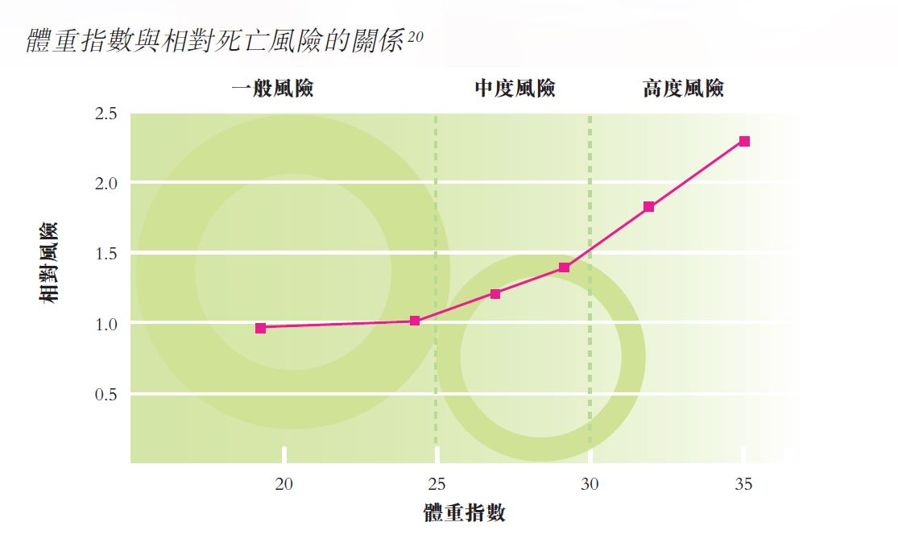
與肥胖相關之健康問題的相對風險
Relative health risk with overweight & obesity
稍微增加 1 至 2 倍 Risk increased slightly from 1-2 times | 中度增加 2 至 3 倍 Risk increased moderately between 2-3 times | 大幅增加逾 3 倍 Risk increased substantially by over 3 times
某幾類癌症 （結腸癌及停經後婦女所患的乳癌) Some specific cancers (Colon and postmenopausal breast cancer) | 冠心病 Coronary disease | 糖尿病 Diabetes
生殖激素異常 Reproductive hormone abnormalities | 高血壓 Hypertension | 膽囊疾病 Gallbladder Disease
腰痛 Lower back Pain | 骨關節炎 Osteoarthritis | 血脂或膽固醇水平異常 Abnormal level of triglyceride or cholesterol
生育力受損 Impairment of Fertility | 痛風症 Gout | 睡眠窒息症 Sleep Apnea Syndrome
Source: http://www.info.gov.hk/healthzone/chp/grp-pmpdb-obesity_tc.pdf

Slide 7

TLS®健康生活纖營計劃方案是甚麼 ？
What is TLS® Weight Loss Solution ?
隨時， 隨地，
任何人可以成功系統
ANYTIME, ANYWHERE,
AND IT WORKS FOR ANYONE
真實故事
真實健康
真實支持
TRUE STORIES
TRUE HEALTH
TRUE SUPPORT

Slide 8
TLS®健康生活纖營計劃方案是甚麼 ？
What is TLS® Weight Loss Solution ?
低升糖指數飲食
身體構成
行為修正
Low Glycemic Index Diet
Body Composition
Behavior Modification

Slide 9

獲得滿足感

Slide 10
成為品牌代言人 Become Brand Representative

Slide 11


開展你的TLS事業
Start your TLS Business

Slide 12
TLS®市場銷售策略
TLS® SALES STRATEGY
TLS® 課程
TLS® Day 1 & Day 2 訓練
TLS® 概覽
TLS® 教練
授證 TLS®教練
授證 TLS®訓練員
TLS® CURRICULUM
TLS® Day 1 & Day 2 Training
TLS® Overview
TLS® Coach
Certified TLS® Coach
Certified TLS® Trainer

Slide 13
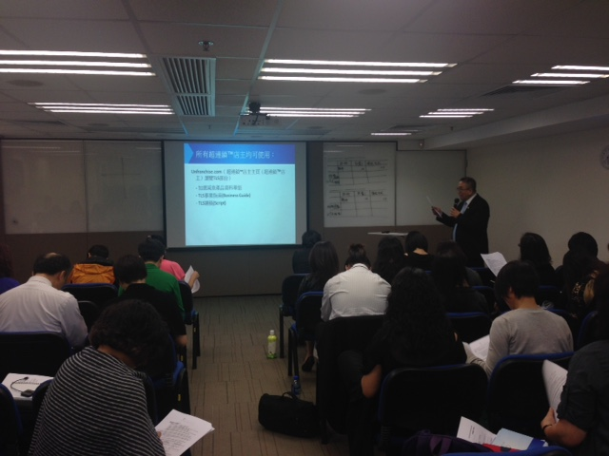
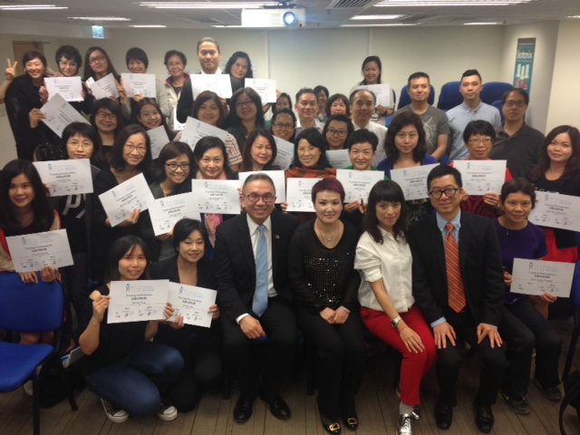

Slide 14
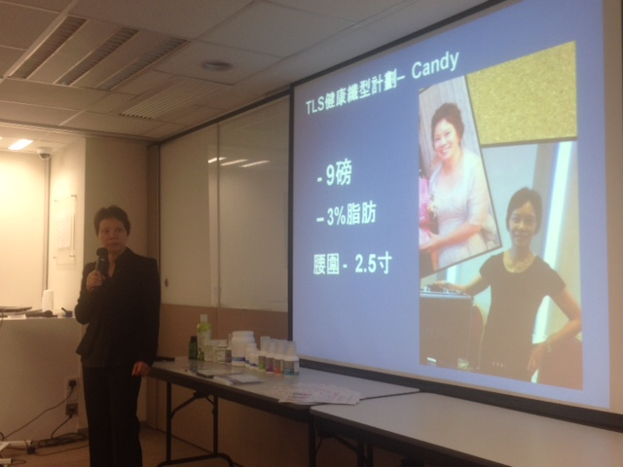
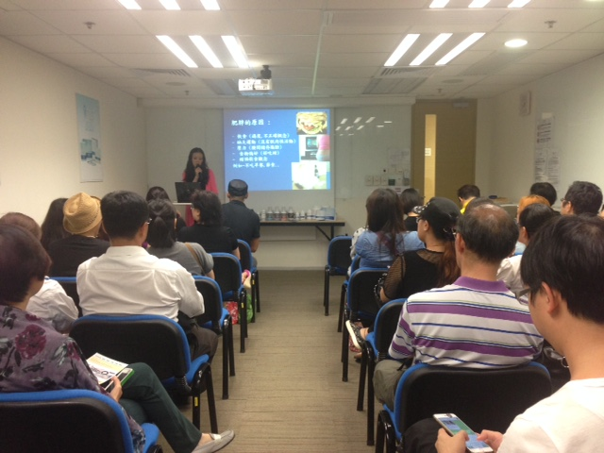
TLS 簡介 Overview

Slide 15
TLS 12週小組 TLS 12-Week Program

Slide 16
TLS畢業禮 Graduation

Slide 17
TLS overview TLS 簡介
TLS 12 week 12週小組
Graduation 成功畢業
TLS Day 1
TLS Day 2
TLS Coach TLS 教練
TLS成功模式
TLS Success Cycle

Slide 18
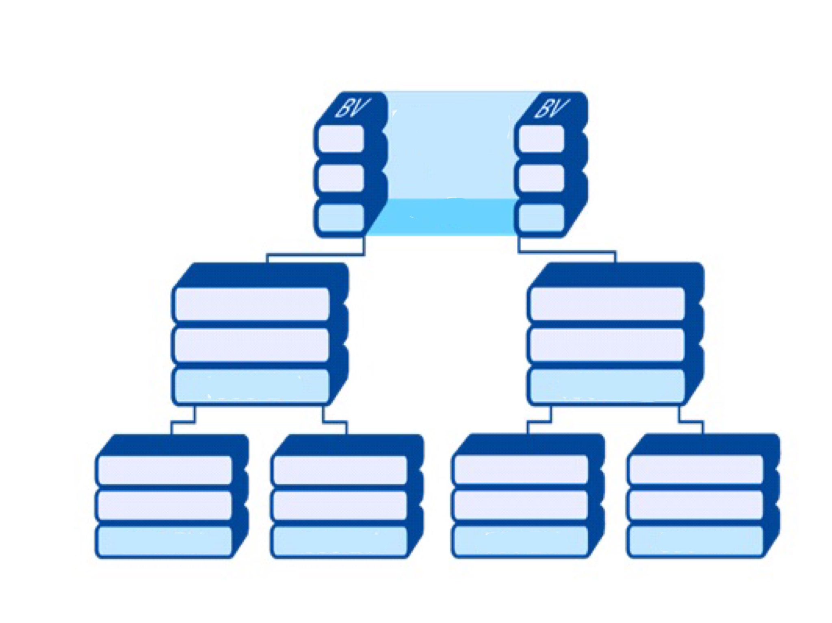
基本十 七人強
Base 10 Seven Strong
你 You
TLS
TLS建立你的七人強
Build your 7 Strong with TLS
TLS
TLS
TLS
TLS
TLS
TLS

Slide 19












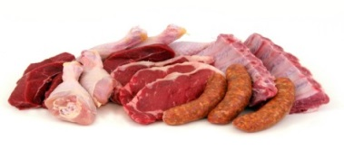

CONVERT SPENDING INTO EARNING
雜項開銷
Miscellaneous
個人保養產品與服務
Personal care products and services
閱讀
Reading
雜項開銷
個人保養產品與服務
雜項開銷
個人保養產品與服務
娛樂
Entertainment
閲讀
娛樂
閲讀
娛樂
健保
Healthcare
食品
Food
健保
健保
食品
食品
為您而設
交通
Transportation
住房
交通
住房
交通
服裝與服務
服裝與服務
服裝與服務
Clothing and services
住房
Housing

Slide 20



TLS®支援
美安購物年金
TLS® FEEDS YOUR
SHOPPING ANNUITY

Slide 21
無限市場商機
效果顯注
成為產品代言人
所有人可以分享TLS
TLS 教育支援
建立客戶
帶領小組，建立團隊
TLS支援購物年金
Unlimited opportunity
TLS works
Become expert in product
Can be shared by anyone
TLS Education support
Build your customer base
Lead the group, build your team
TLS feeds your Shopping Annuity

Slide 22
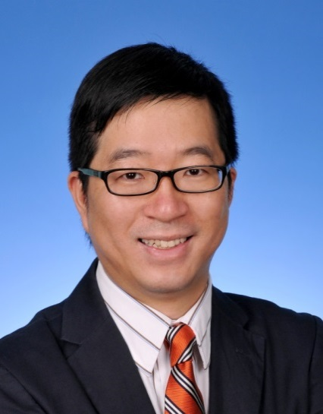
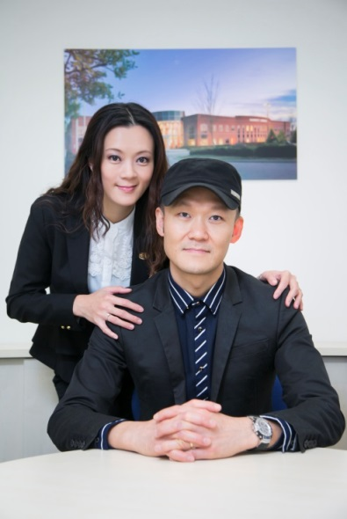
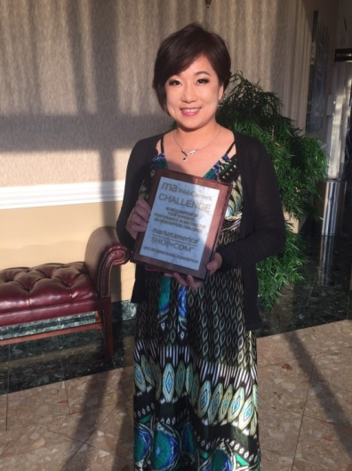
TLS Day 1 Training
下一步 THE NEXT STEP
日期：10月4日（日）
時間：12:30 – 6:30 pm
費用：$250
Date: October 4, 2015
Time: 12:30 – 6:30 pm
Fee: $250
TLS Day 2 Training
日期：11月15日（日）
時間：12:30 – 6:30 pm
費用：$250
Calvin Ip
Helen Lin & Luk Ka Wai
Maggie Su
Date: November 15, 2015
Time: 12:30 – 6:30 pm
Fee: $250
www.hk.unfranchise.com

Slide 23
WELCOME TO TLS WEIGHT LOSS
SOLUTION
D

Slide 24


2015 美安香港成功領袖會議
MHK Leadership Conference 2015

